Slide 1
MLFlow and MLFlow Recipes :
Ayush singh (intern)

Slide 2
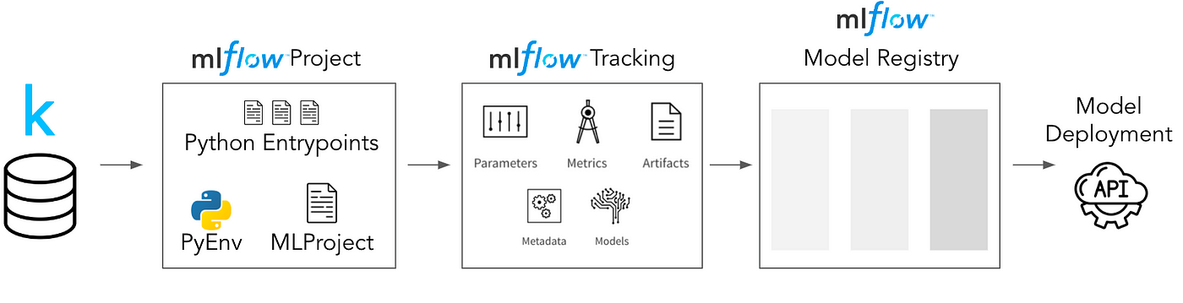
MLflow is an open-source platform for managing the machine learning lifecycle. Some of the key features of MLflow include:
Tracking: MLflow tracking allows you to log parameters, metrics, and artifacts from your machine learning experiments. This data can be used to track the progress of your experiments, compare different runs, and identify the best performing models.
Model management: MLflow model management provides a way to store, version, and deploy machine learning models. This makes it easy to share models with others and to deploy them to production.
Model registry: The MLflow model registry is a central repository for storing machine learning models. The registry allows you to track the lineage of your models, manage their lifecycle, and deploy them to production.
Model serving/projects: MLflow model serving provides a way to deploy machine learning models as REST endpoints. This makes it easy to integrate machine learning models into your applications.

Slide 3
MLFlow Recipes : (earlier known as MLFLow Pipelines)
It is a framework that enables data scientists to quickly develop high-quality models and deploy them to production. It offers several key features:
Feature | Description
Predefined templates | MLflow Recipes provides a number of predefined templates for common ML tasks, such as regression modeling, classification, and clustering. These templates can be used to get started quickly and focus on building great models, without having to worry about the boilerplate code that is traditionally required to curate datasets, engineer features, train & tune models, and package models for production deployment.
Intelligent recipe execution engine | The intelligent recipe execution engine accelerates model development by caching results from each step of the process and re-running the minimal set of steps as changes are made. This can save a significant amount of time, especially when working with large datasets.
Production-ready structure | The modular, git-integrated recipe structure dramatically simplifies the handoff from development to production by ensuring that all model code, data, and configurations are easily reviewable and deployable by ML engineers.
Support for multiple ML frameworks | MLflow Recipes can be used with a variety of ML frameworks, including scikit-learn, TensorFlow, and PyTorch.
Support for multiple deployment targets | MLflow Recipes can be used to deploy models to a variety of deployment targets, such as Amazon SageMaker, Azure Machine Learning, and Google Cloud ML Engine.
Integration with MLflow Tracking | MLflow Recipes integrates with MLflow Tracking, which allows you to track the metrics and artifacts generated during model development and deployment.

Slide 4
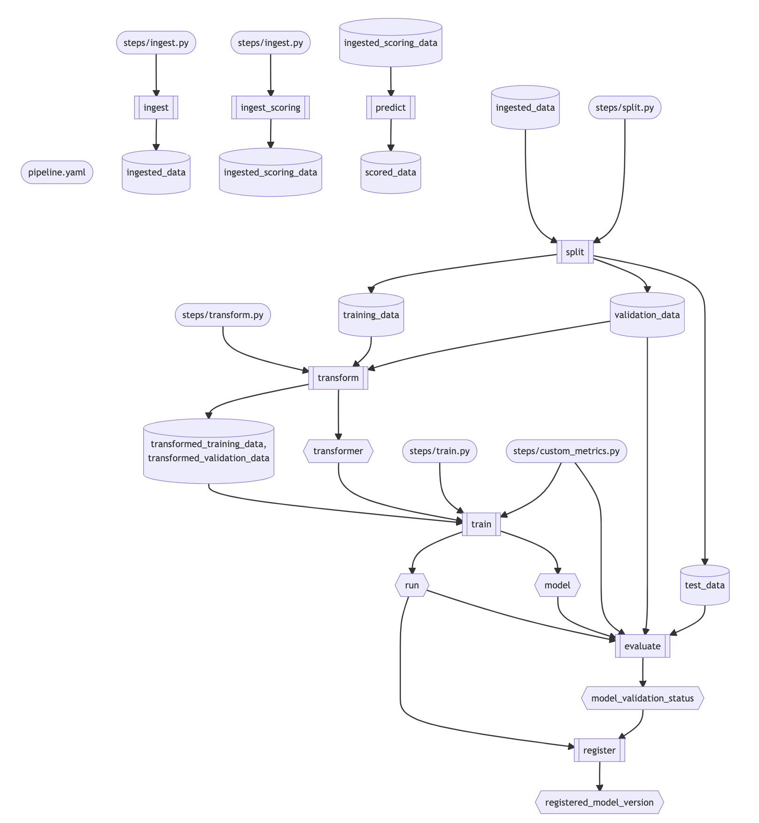
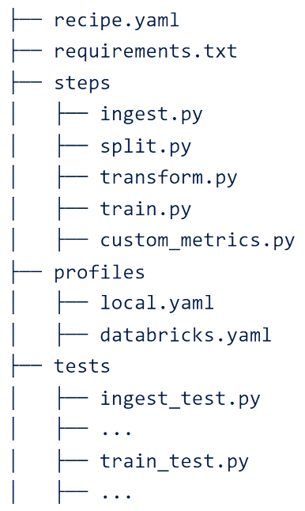
On Local Environment :
(Types of Files it Includes)
(If used)
Broad Overview of How MLFlow Pipeline Works (for Regression Model ) :

Slide 5
MLFlow Recipe on Local Environment Vs Databricks :
Local Environment:
Flexibility: | Running MLflow Recipes in a local environment gives you more flexibility in terms of the hardware and software configurations you can use. You can choose the specific versions of libraries, frameworks, and tools that best suit your requirements.
Resource Management: | MLflow Recipes can be executed both in a local environment and on Databricks, providing flexibility in where you run your machine learning workflows. Here are some key considerations for running MLflow Recipes in each environment: In a local environment, you have direct control over resource allocation, such as CPU, memory, and disk space. You can optimize resource utilization based on your machine's capabilities.
Data Accessibility: | Accessing data in a local environment may involve reading files from the local file system or connecting to local databases. It's important to ensure that your MLflow Recipe has the necessary permissions and configurations to access the required data sources.
Databricks:
Scalability: | Databricks offers scalable cloud-based infrastructure, allowing you to run MLflow Recipes on clusters with varying sizes and capabilities. This enables you to leverage distributed computing resources for large-scale experiments and training.
Collaboration: | Databricks provides collaborative features that facilitate team collaboration. Multiple users can work on MLflow Recipes simultaneously, share notebooks, and leverage Databricks' workspace and version control capabilities.
Integrated Ecosystem: | Databricks integrates with various data and machine learning tools, such as Apache Spark, Delta Lake, and MLflow. This integration simplifies data ingestion, preprocessing, and analysis tasks, providing a unified environment for end-to-end machine learning workflows.
Managed Environment: | Databricks takes care of infrastructure management, including resource provisioning, cluster setup, and monitoring. This allows you to focus on developing and running MLflow Recipes without worrying about the underlying infrastructure.

